Slide 1
Genetic Analysis of genomic data : Genomic Selection
Basic concepts and examples
Rama Bangera
Akforsk Genetics, Sunndalsøra, Norway

Slide 2
Contents
Genomic selection concepts
Genomic models
Data structures for genomic analysis
List of softwares used to analyze genomic data
Examples using rrBLUP

Slide 3
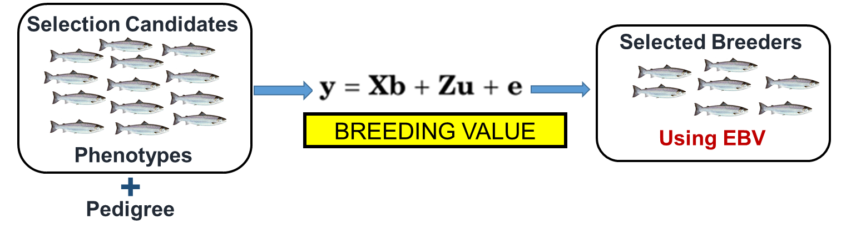
Traditional Selection (BLUP)
Phenotype records of the candidate and/or relatives along with pedigree information to estimate the genetic merit – estimated breeding value
Works well for med to high heritability traits and traits with own phenotypes ( eg. Body weight)
Less effective for low heritable, sex limited and sib traits (disease resistance, fillet yield)
For disease: No within family selection on tested candidates due to disease transmission risks
Accuracy increases with : own phenotypic records and information on relatives

Slide 4
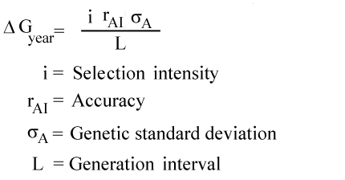
Use of genomic information in Selection
Marker assisted selection (MAS) uses molecular markers in linkage disequilibrium (LD) with QTL.
  Trace limited number of QTL with markers
  Limited proportion of genetic variance is captured by the markers
  Alternative : Trace all the QTL using genome-wide markers
Genomic selection (GS) uses whole genome molecular markers (high density markers covering the entire genome).
Genomic prediction combines marker data with phenotypic and pedigree data (when available) in an attempt to increase the accuracy of the prediction of breeding values
Opportunities in aquaculture
Low heritable and polygenic traits
Within family selection for sib traits (Lillehammer et al., 2013) (disease, fillet yield)
Increase in accuracy of selection

Slide 5
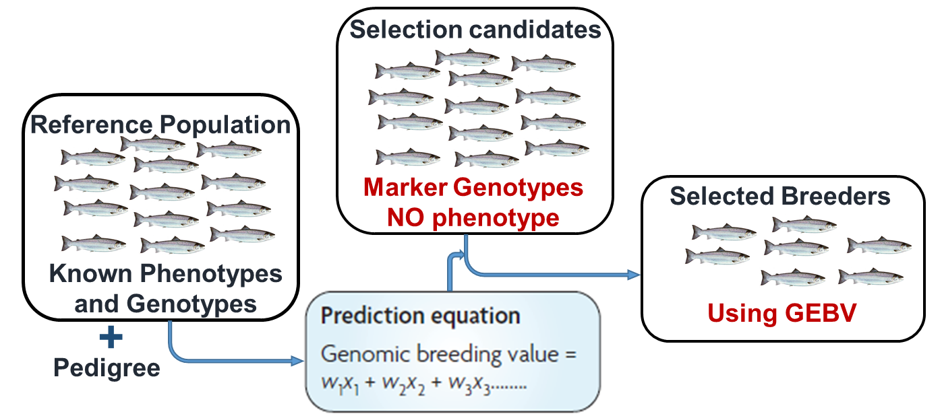
Genomic Selection (Meuwissen et al., 2001)
GS is applied in a population that is different from the reference population in which the marker effects were estimated.
GS uses two types of datasets:
  The training set: the reference population in which the marker effects were estimated; it contains phenotype records, marker genotype and pedigree information (kinship information)
  The validation set: contains the selection candidates that have been genotyped (but no phenotypes). The genomic breeding value (GEBV) of animals with only genotypes are predicted as the sum of marker effects.
F_17/09/2016 / PIE DE PÁGINA
Notes:
Uses genome-wide panel of dense markers so that all QTLs are in LD with at least one marker

Slide 6
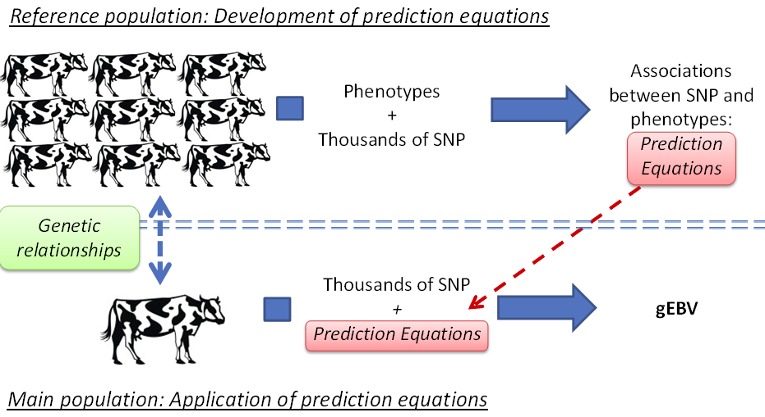
Genomic Selection: typical livestock industry
Possible to select young bulls : saves time and money on progeny testing (4 years)

Slide 7
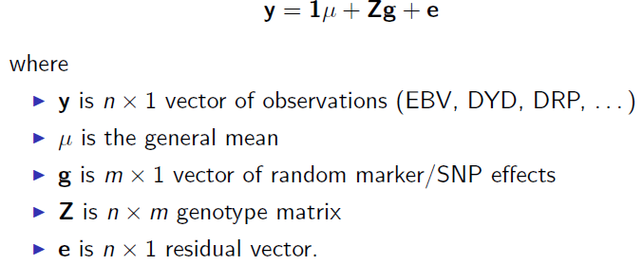

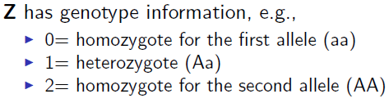
Basic genomic model
Regression of Marker genotypes Phenotypes – the simplest model

Slide 8
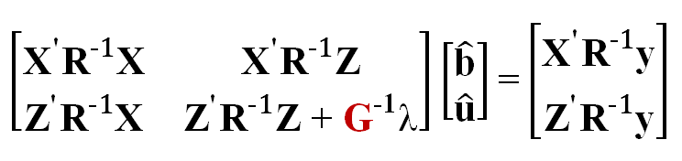
Genomic BLUP (GBLUP) – mixed model
y = Xb + Zu + e
Xb is the mean (other fixed effects could be added)
Z is incidence matrix for marker effects
u is vector of additive genetics effects that correspond to allele substitution effects for each marker
We let the sum Zu across all marker loci (m) to be equal to the vector of breeding values Za = u
Lambda is defined as the sum across loci 2Σpi1-pi times the ratio of error and additive genetic variance
(VanRaden 2008)

Slide 9
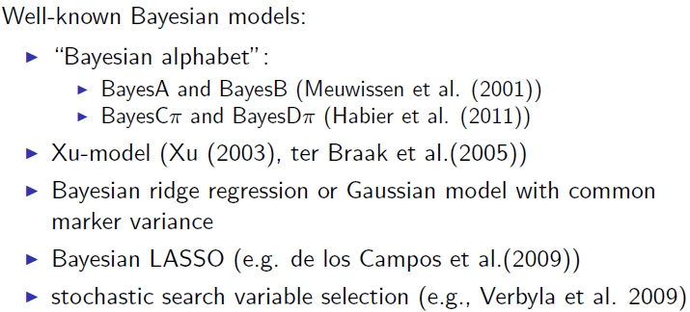
Genomic evaluations in dairy cattles
Bayesian Genomic Models

Slide 10
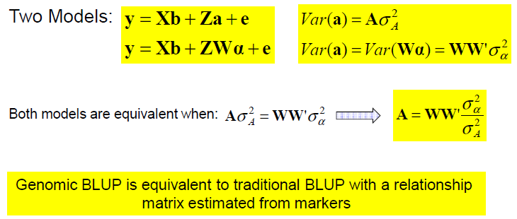
BLUP and genomic BLUP (GBLUP)
GBLUP is the most commonly used method
We will concentrate on BLUP and GBLUP

Slide 11
Software commonly used
BLUPF90 Family of Programs (Ignacy Misztal -University of Georgia)
      http://nce.ads.uga.edu/wiki/doku.php
      GBLUP and Bayesian Models
      http://nce.ads.uga.edu/wiki/doku.php?id=course_information_-_uga_2016
GS3 (A. Legarra, INRA)
      Powerful for Bayesian Models and also for GBLUP
      https://qgsp.jouy.inra.fr/index.php?option=com_content&view=article&id=60&Itemid=67
ASREML and DMU
      GBLUP and Bayesian Methods
rrBLUP : Ridge Regression and Other Kernels for Genomic Selection
      https://cran.r-project.org/web/packages/rrBLUP/index.html
      Possible to run BLUP and GBLUP
BGLR : Bayesian Generalized Linear Regression.
      https://cran.r-project.org/web/packages/BGLR/index.html
WILL SHOW EXAMPLES using rrBLUP

Slide 12
Genomic analysis in rrBLUP
Install rrBLUP
      install.packages("rrBLUP")
      library(rrBLUP)
Open R code : Gsanalysis.R
      https://cran.r-project.org/web/packages/BGLR/index.html
  Data structure (data.txt)
    The data file has both phenotype and genotype
    First 8 columns of the data are related to phenotypes
    Remaining 8000 columns are for SNP genotypes coded as:
      # AA, TT =1
      # AG, GC, etc = 0
      # GG, CC = -1
      # missing = NA
  The pedigree file : pedigree.txt : information of animal, sires and dams
  The data is from a disease challenge test where trait of interest is «day» which is nothing but numeber of days the fish survived the challenge test with a pathogen
  This is a subset of the data from a commercial company, used here for non-profit, demonstration purpose

Slide 13
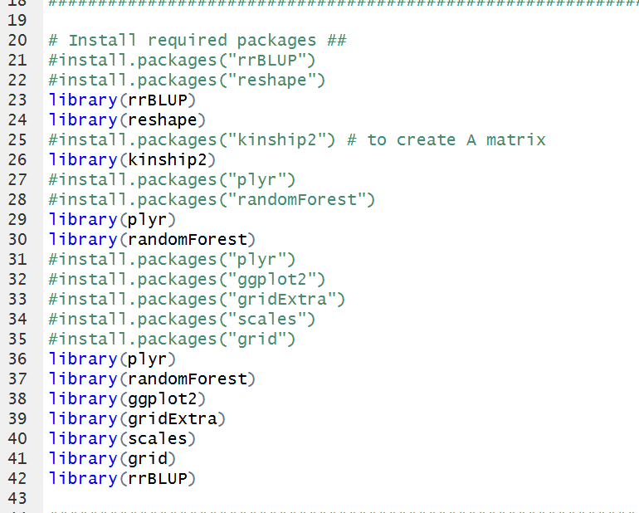
Install required packages

Slide 14
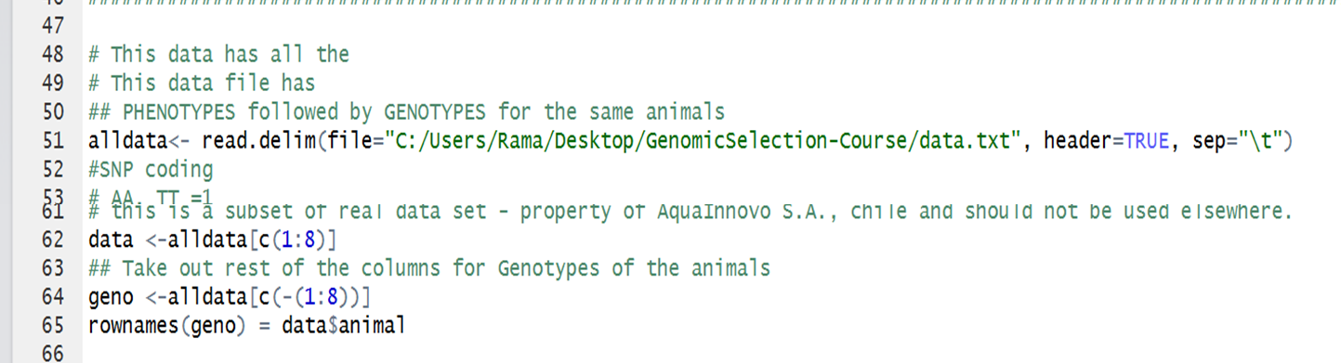
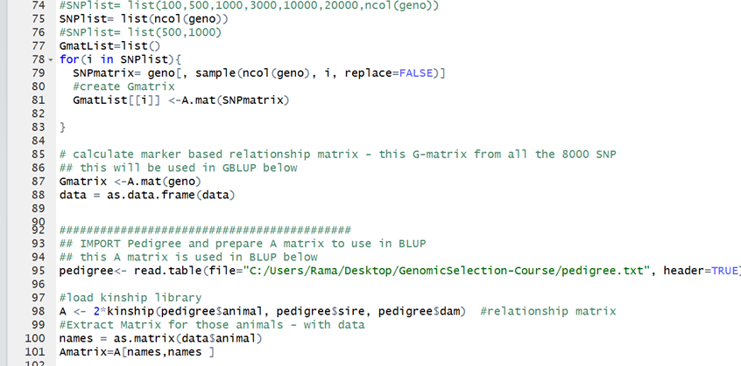
Import data and prepare phenotype and genotype file
Data= phenotype file, geno= genotype file
Prepare genomic relationship matrix – Gmatrix

Slide 15
Import pedigree : Amatrix
  Gmatrix : used in GBLUP
  Amatrix : used in BLUP

Slide 16
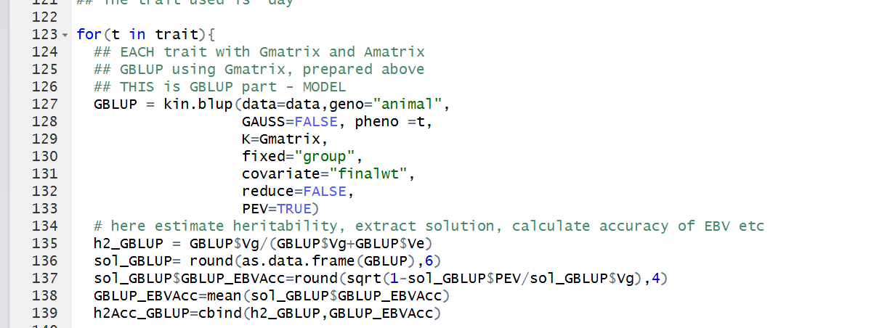
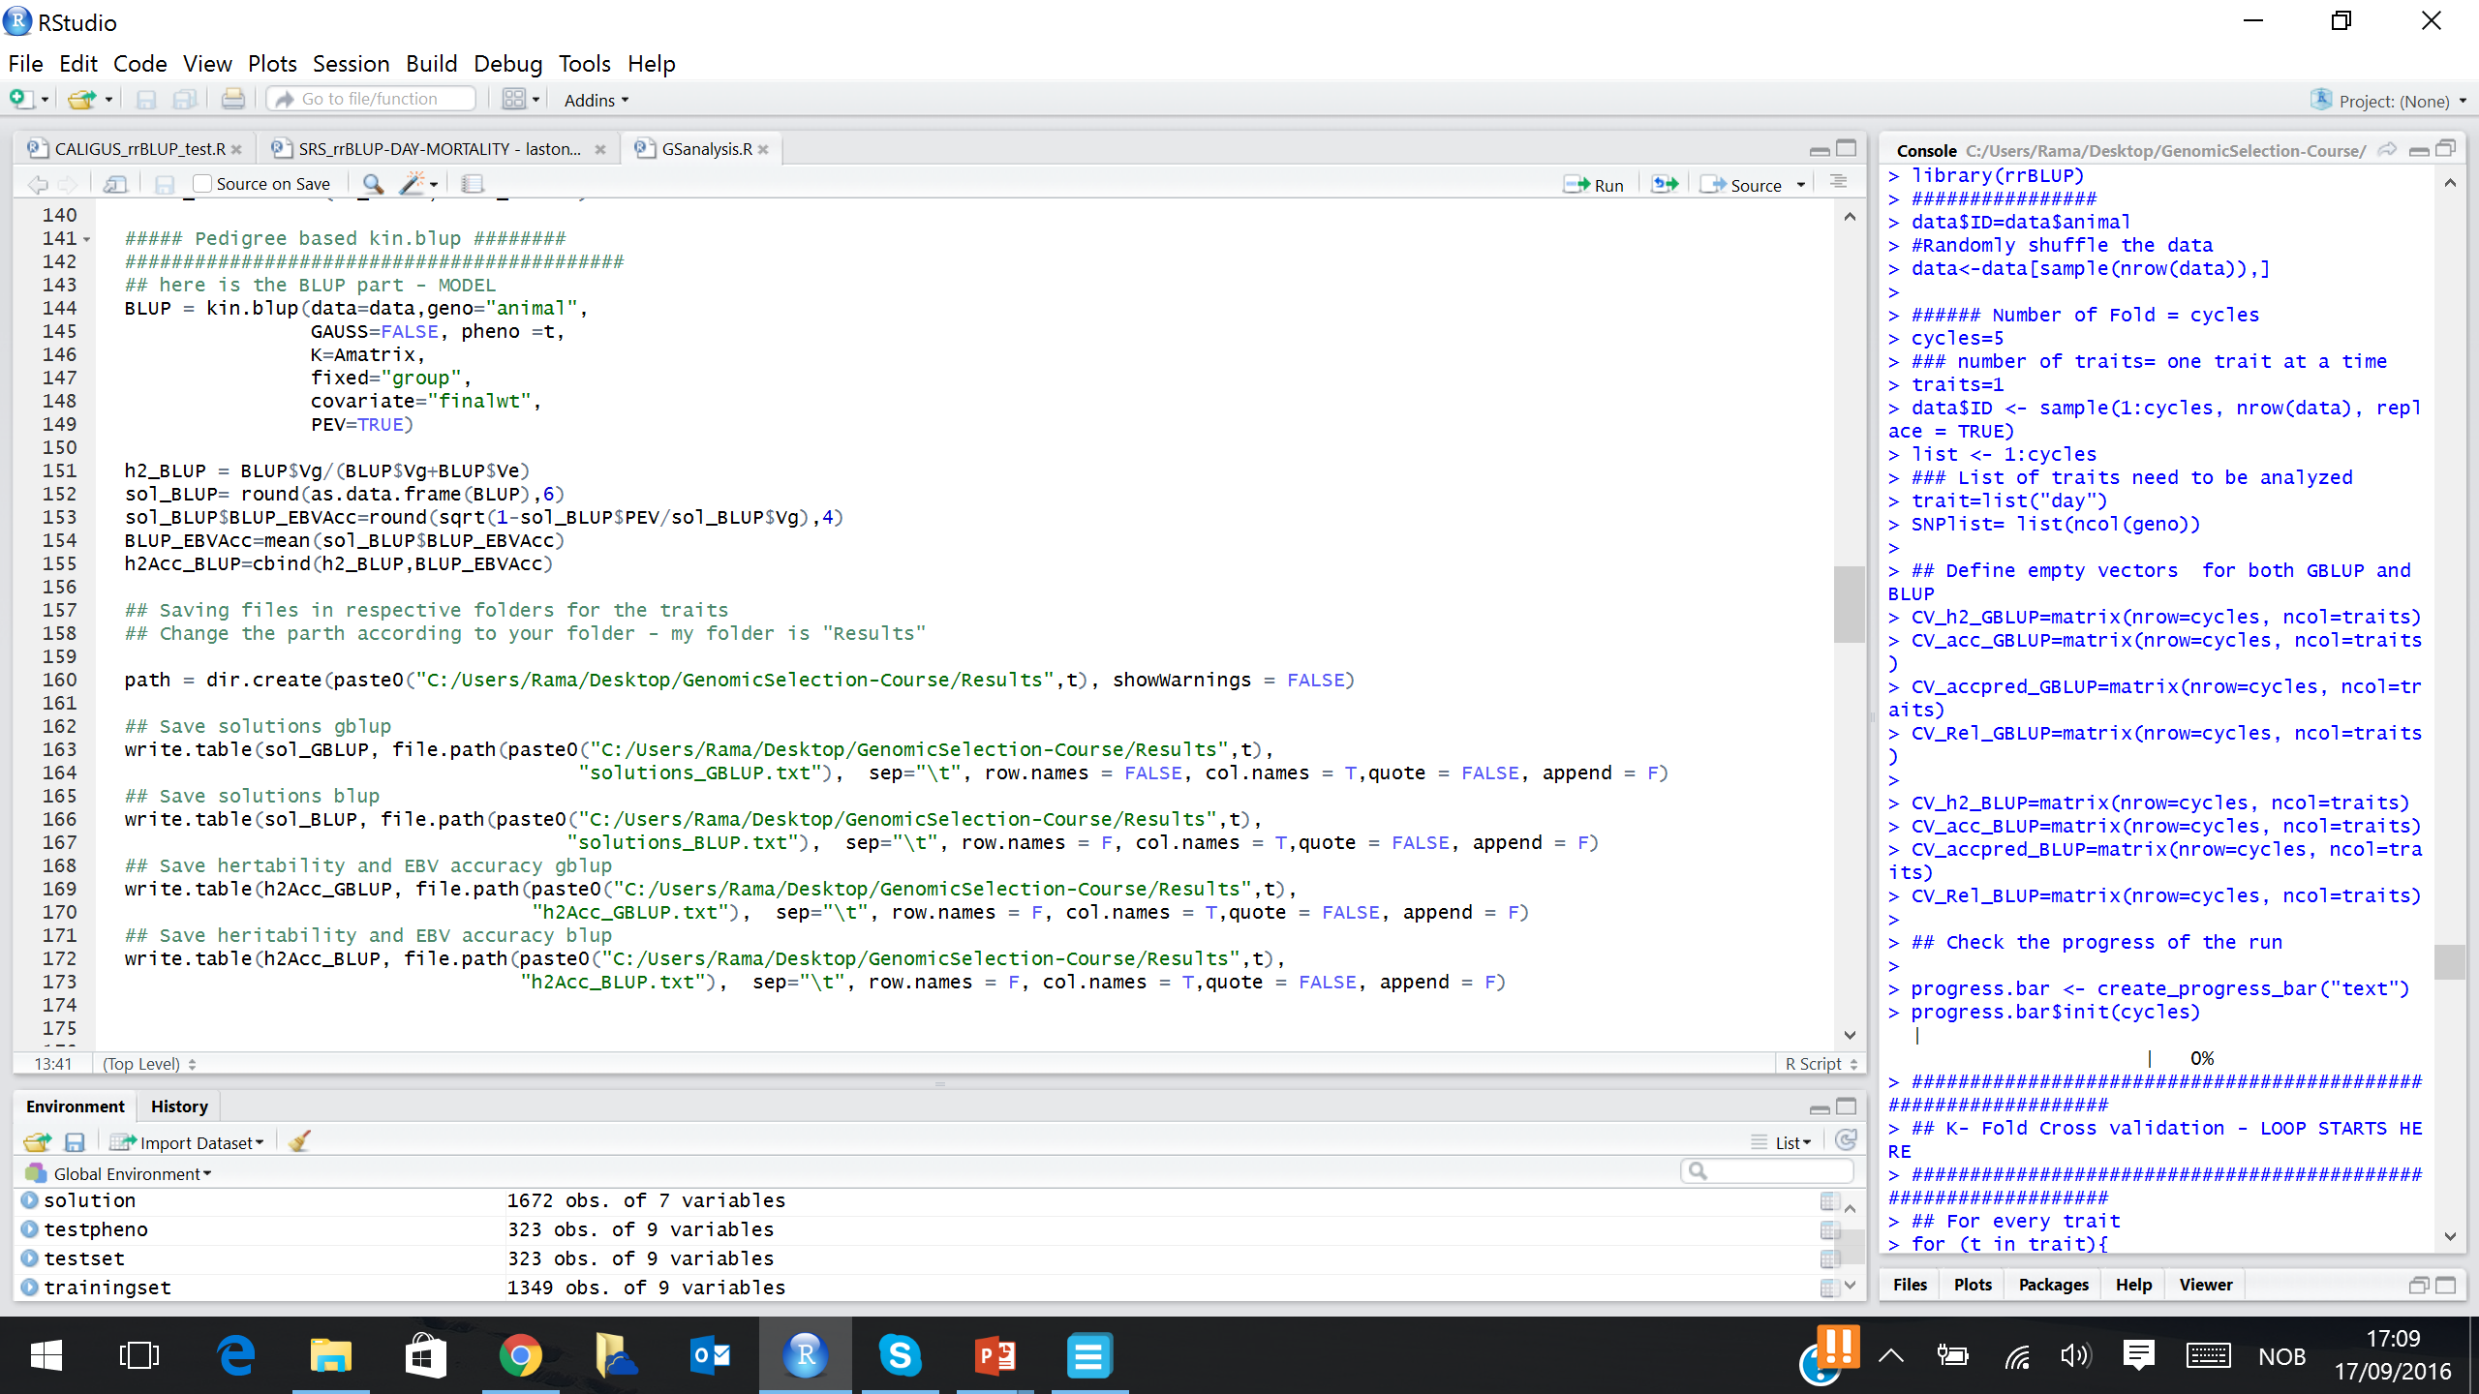
Run GBLUP, BLUP for trait “day”, estimate heritability, extract solutions and save as separate files
  GBLUP part
  BLUP part

Slide 17
Save estimate of heritability, extract solutions and save as separate files
  Solutions_GBLUP.txt: solutions from the analysis
  h2Acc_GBLUP.txt : hertiability estimated from GBLUP and Accuracy of EBV (check formula in the script)
  Similary files for BLUP
  !! KEEP an empty folder «Results» in the working directory, the script will save the output there

Slide 18
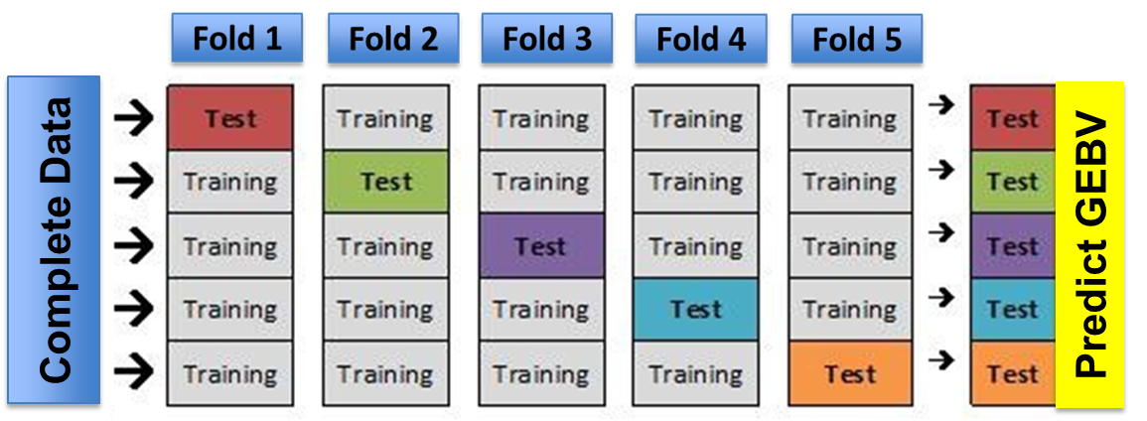
Prediction Accuracy : 5 fold cross validation
Accuracy
Accuracy (Reliability) : squared correlation between predicted (G)EBVs of a given model and the recorded phenotype divided by estimated heritability of the trait
Average accuracy of 5 folds
Marker density : 500, 1K, 3K, 10K, 20K and 50K
  Low cost genotyping
F_17/09/2016 / PIE DE PÁGINA
Notes:
Uses genome-wide panel of dense markers so that all QTLs are in LD with at least one marker

Slide 19
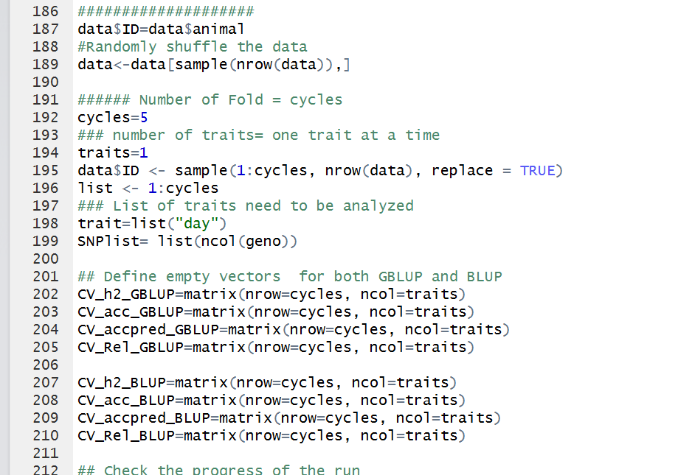
Five fold cross validation part
  Deviding data into five folds (cycles=5) to be used in the later loop
  Defining empty vectors (this is needed) : where results will be saved from the loop

Slide 20
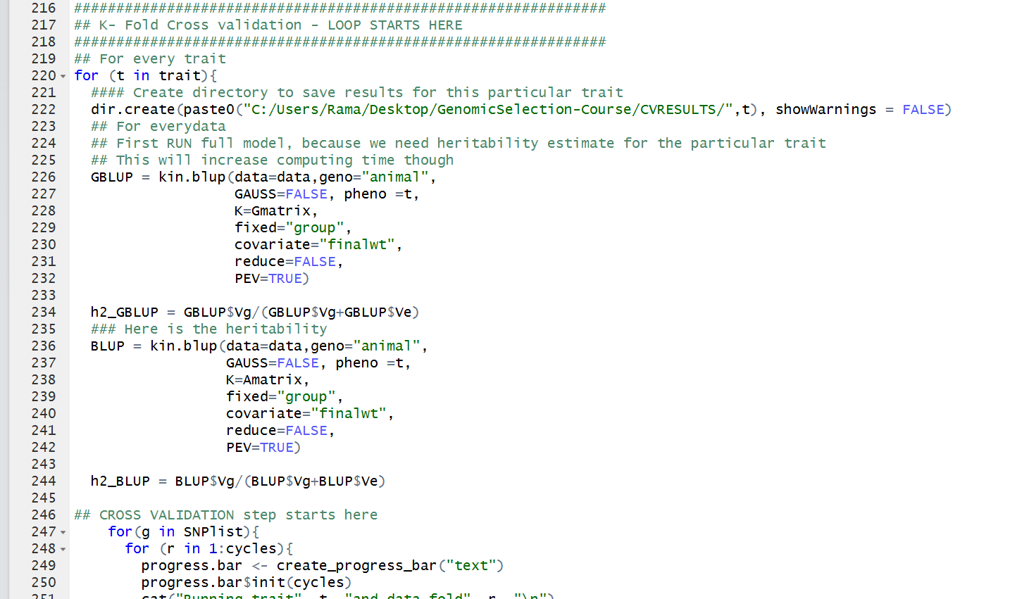
Five fold cross validation : start of loop
  In this first part, I am running both GBLUP and BLUP again to get heritability estimate. This heritability estimate will be used to calulate prediction accuracy
  If you have prior estimated heritability, this part can be skipped

Slide 21
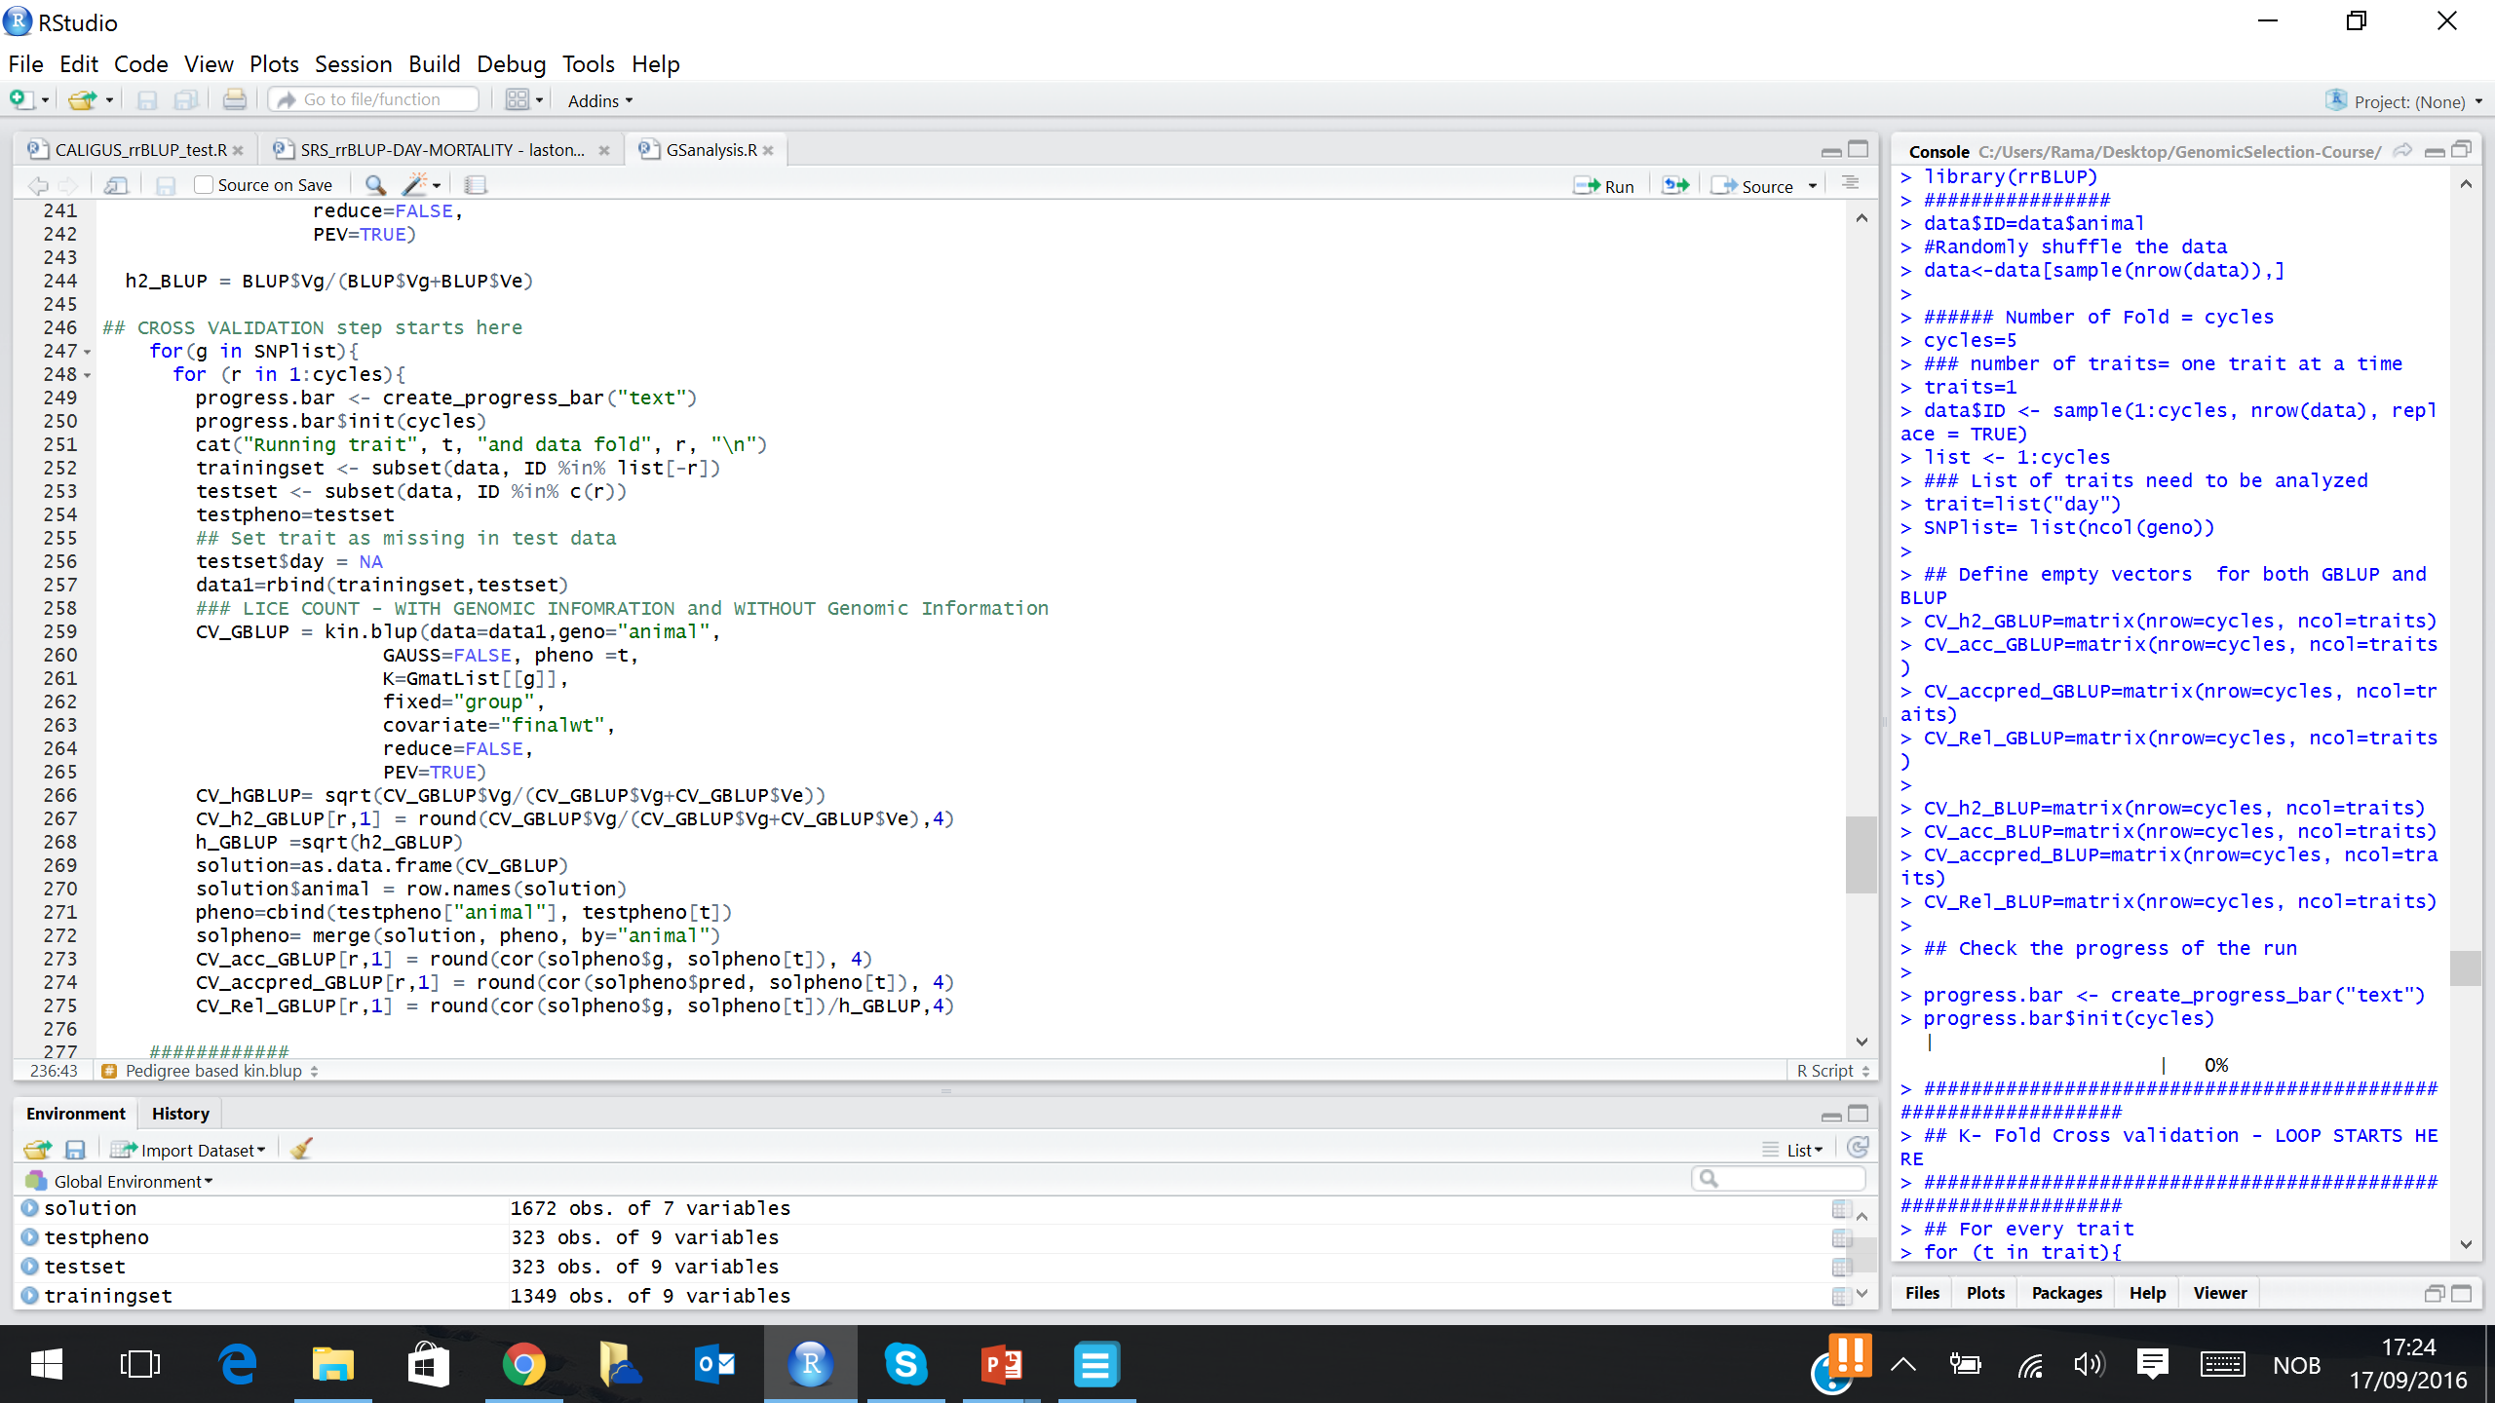
Five fold cross validation : start of CV for GBLUP
  In this first part, its running GBLUP for 5 different set of data and saving the reliability (CV_Rel_GBLUP), check formula
  Similarly follows for the BLUP

Slide 22
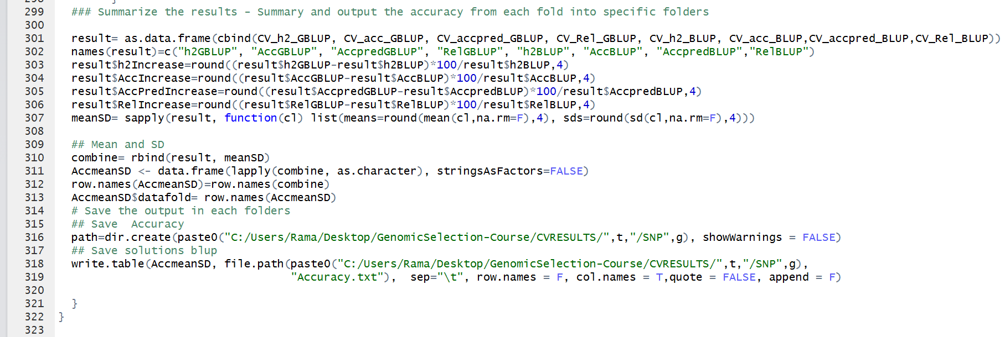
Summarize and save results for BLUP and GBLUP
  Saved as seperate file for GBLUP and BLUP
  Remember to keep the folder «CVRESULS» in the working directory

Slide 23
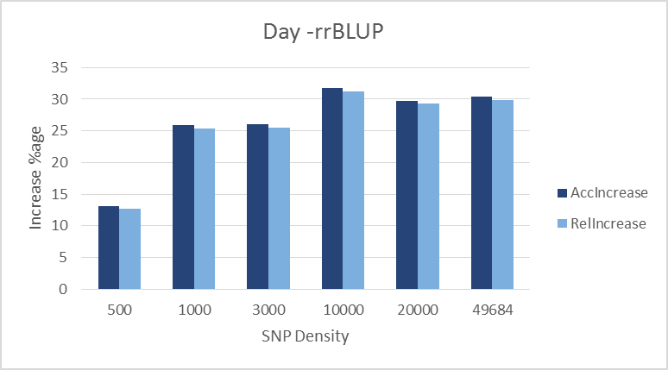
RESULTS – % Increase in Accuracy/Reliability
Accuracy: ~ 32 and Reliability : ~ 31%
Accuracy = Corr(EBV, Phenotype)
Reliability = Corr(EBV,Phenotype)/h
The results shows that, there is increase in accuracy of GEBV estimated from GBLUP than EBV estimated from BLUP
Increase in accuracy means, better selection of candidates and increase in genetic gain per generation

Slide 24

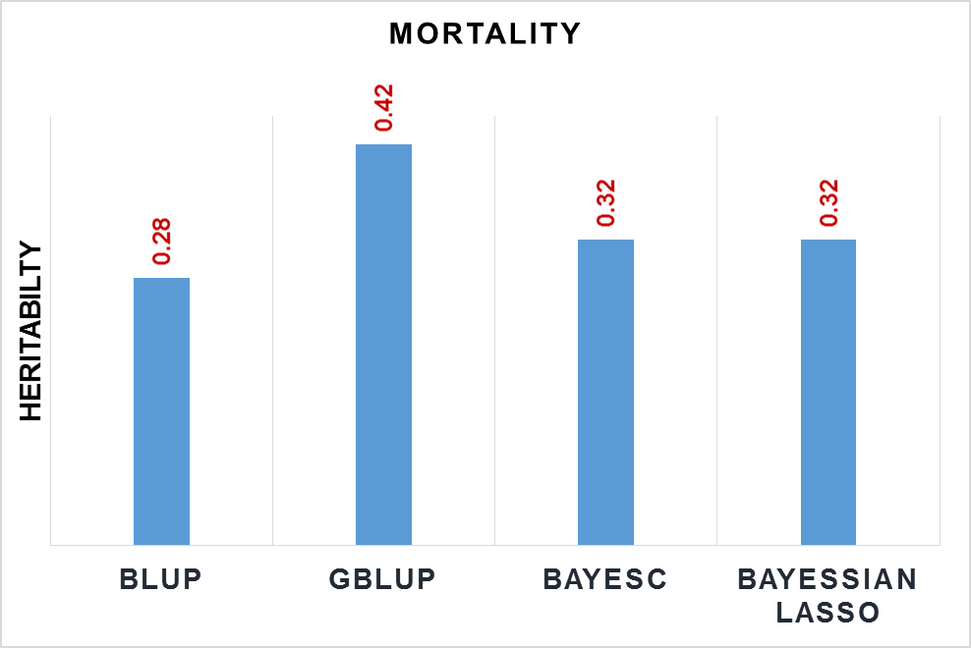
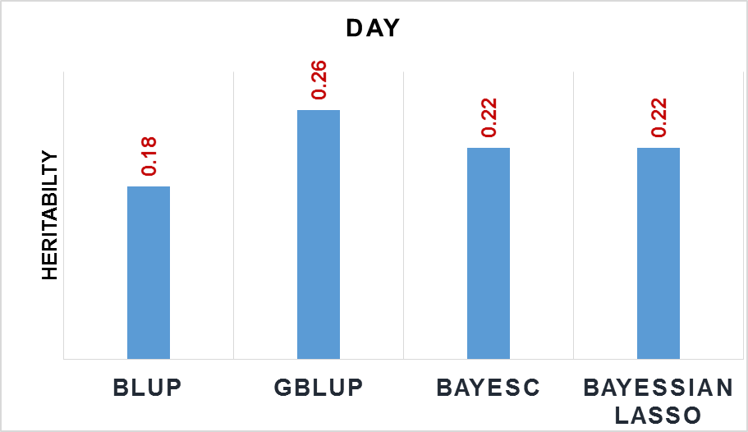
Heritability estimates – different models
Full data set
Estimates at 50K
Higher estimate using genomic information
Notes:
Uses genome-wide panel of dense markers so that all QTLs are in LD with at least one marker

Slide 25
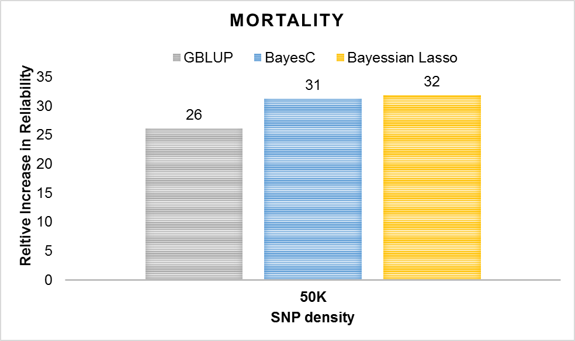
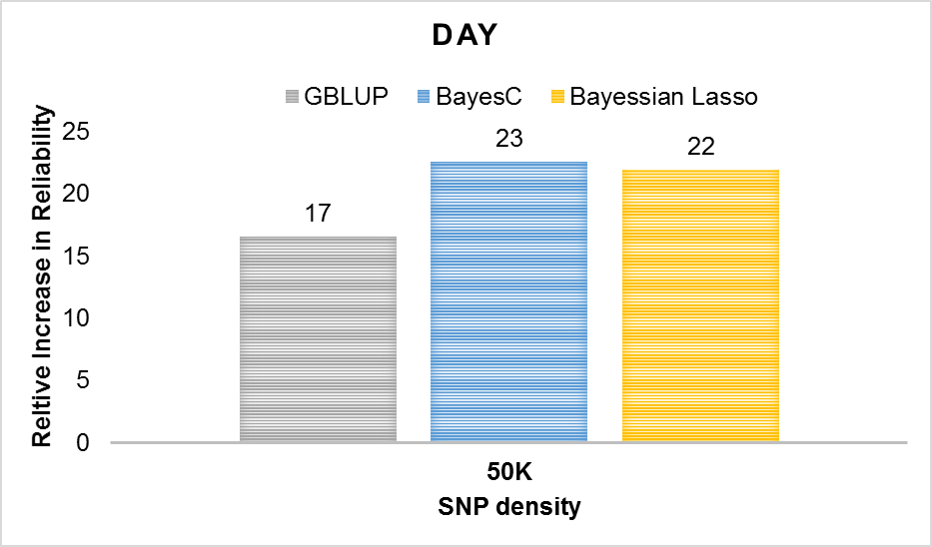
Cross validation accuracy – 50 K
Relative to BLUP
  Up to 22 % for DAY
  Up to 31% for MORTALITY
Notes:
Uses genome-wide panel of dense markers so that all QTLs are in LD with at least one marker

Slide 26
Summary
GS can be applied without having prior knowledge about QTL.
Use of genomic information increases the accuracy of selection and hence increased genetic gain per generation
Possible to predict GEBV for animals with only genotyped but phenotypes : the main advantage of GS for difficult traits such as disease resistance, meat quality, milk yield (for bulls) etc
There are several models, but simplest model GBLUP should work in most cases, but need to be compared with other models case by case
There are several softwares, choose best one based on the requirement

Slide 27
Thank you

